Slide 1
Integrated Math 2 Unit 6 Toolkit (learning targets)
Reminder: keep all notes in orange folder!! They may be used on group quizzes and both final exams. These notes are a study tool to help you prepare for each unit test.

Slide 2
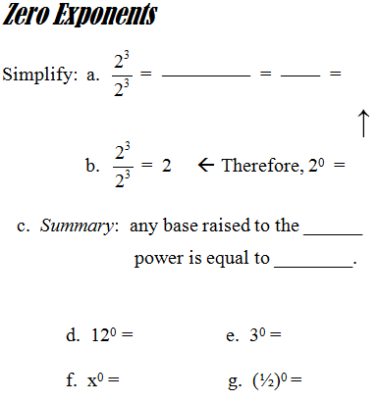
Tool-Kit

Slide 3
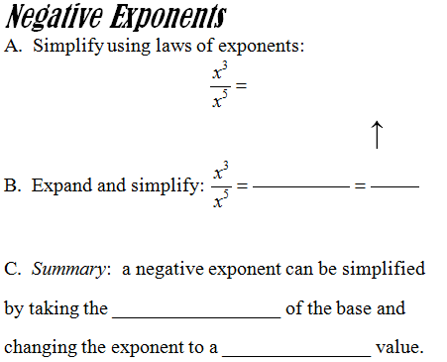
Tool-Kit

Slide 4
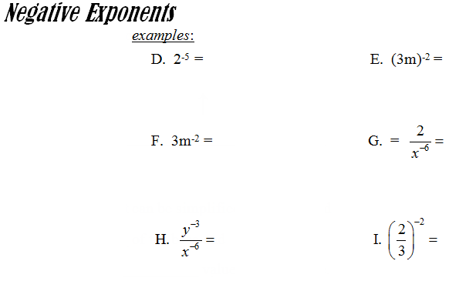
Tool-Kit

Slide 5
Tool-Kit

Slide 6
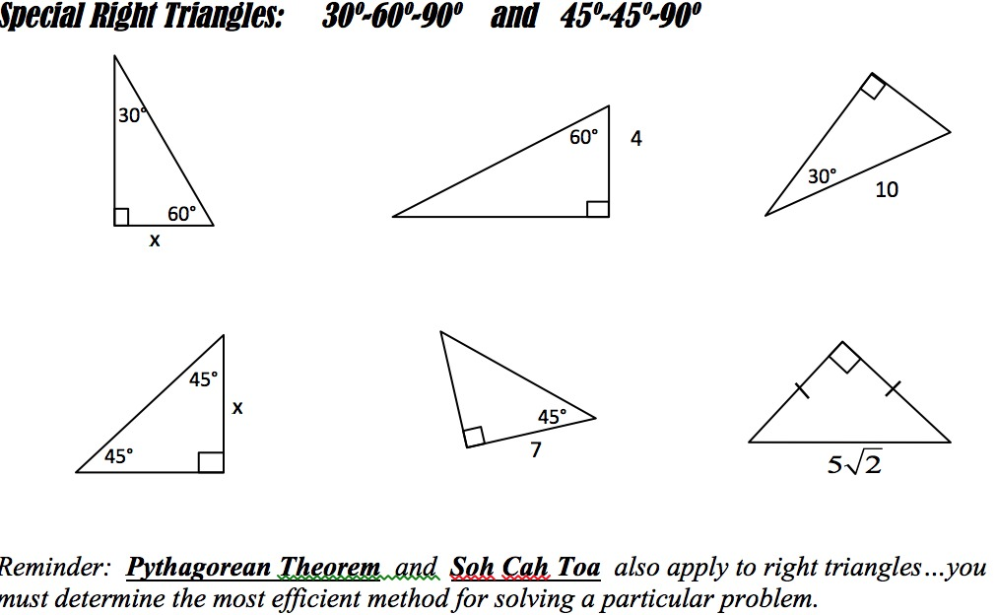
Tool-Kit

